Slide 1

By: Alfiya banu k Batch code: 2021- 6138 Center: Banglore

Slide 2



Slide 3
Description:
This is a Hotel Management tool which can be used to manage activities like storing customer details, booking rooms of four different types, ordering food for particular rooms, unbooking rooms and showing the bill.
It can also be used to see different room features and room availability. It is a menu driven program and it runs until the user exits.
File handling has been used to store the current status of the hotel(customer details, booked rooms, food ordered) in a file once the program exits so that when we restart the program, the old details are not lost.
The program reads the file when it restarts to know the previous status of the hotel. Writing of file has been done in a separate thread as it can be done parallel.
.

Slide 4
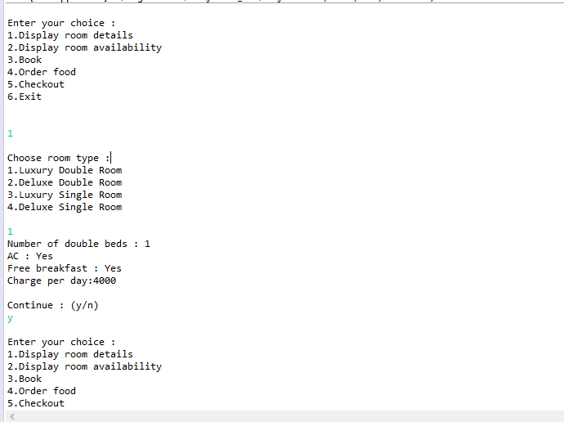
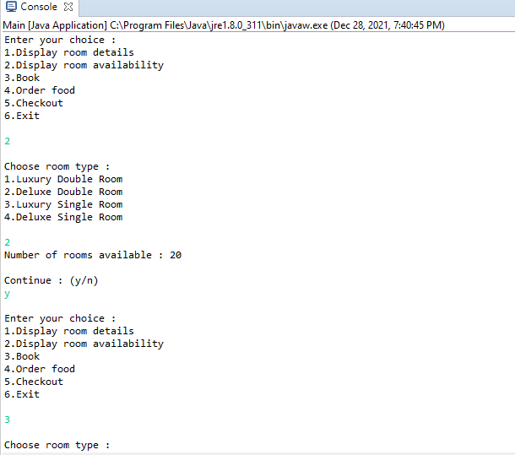
OUTPUT:

Slide 5
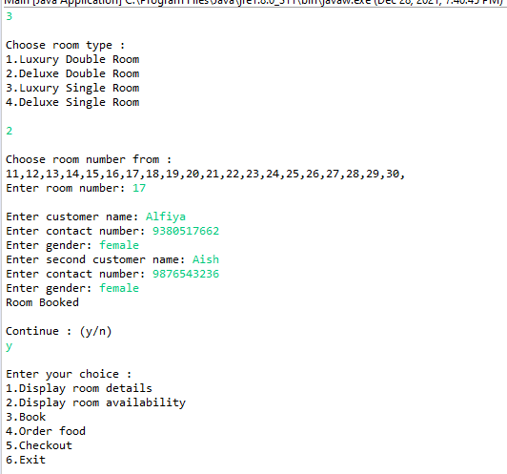

Slide 6
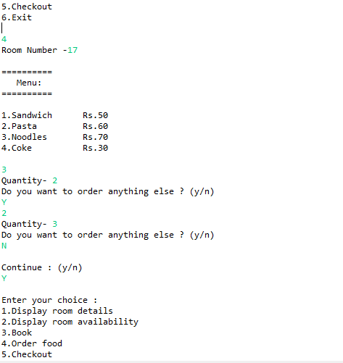
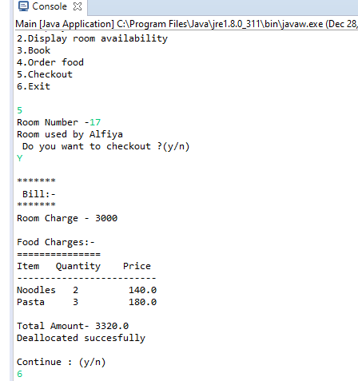

Slide 7
THANK YOU

